Slide 1
Operators and Menus

Slide 2
An operator is a symbol that tells the compiler to perform specific mathematical or logical manipulations. Tableau has a number of operators used to create calculated fields and formulas.

Slide 3
Types of Operator
General Operators
Arithmetic Operators
Relational Operators
Logical Operators

Slide 4
General Operators
Operator | Description | Example
+(addition) | Adds two numbers. Concatenates two strings. Adds days to dates. | 7 + 3 Profit + Sales 'abc' + 'def' = 'abcdef' #April 15, 2004# + 15 = #April 30, 2004#
–(subtraction) | Subtracts two numbers. Subtracts days from dates. | -(7+3) = -10 #April 16, 2004# - 15 = #April 1, 2004#

Slide 5
Arithmetic Operators
Operator | Description | Example
*(Multiplication) | Numeric multiplication | 23*2 = 46
/(Division) | Numeric division | 45/2 = 22.5
%(modulo) | Reminder of numeric division | 13 % 2 = 1
^(power) | Raised to the power | 2^3 = 8

Slide 6
Relational Operators
Operator | Description | Example
= = or = (Equal to) | Compares two numbers or two strings or two dates to be equal. Returns the Boolean value TRUE if they are, else returns false. | ‘Hello’ = ‘Hello’ 5 = 15/ 3
!= or <> (Not equal to) | Compares two numbers or two strings or two dates to be unequal. Returns the Boolean value TRUE if they are, else returns false. | ‘Good’ <> ‘Bad’ 18 != 37 / 2
> (Greater than) | Compares two numbers or two strings or two dates where the first argument is greater than second. Returns the boolean value TRUE if it is the case, else returns false. | [Profit] > 20000 [Category] > ‘Q’ [Ship date] > #April 1, 2004#
< (Less than) | Compares two numbers or two strings or two dates where the first argument is smaller than second. Returns the boolean value TRUE if it is the case, else returns false. | [Profit] < 20000 [Category] < ‘Q’ [Ship date] < #April 1, 2004#

Slide 7
Logical Operators
Operator | Description | Example
AND | If the expressions or Boolean values present on both sides of AND operator is evaluated to be TRUE, then the result is TRUE. Else the result is FALSE. | [Ship Date] > #April 1, 2012# AND [Profit] > 10000
OR | If any one or both of the expressions or Boolean values present on both sides of AND operator is evaluated to be TRUE, then the result is TRUE. Else the result is FALSE. | [Ship Date] > #April 1, 2012# OR [Profit] > 10000
NOT | This operator negates the Boolean value of the expression present after it. | NOT [Ship Date] > #April 1, 2012#

Slide 8
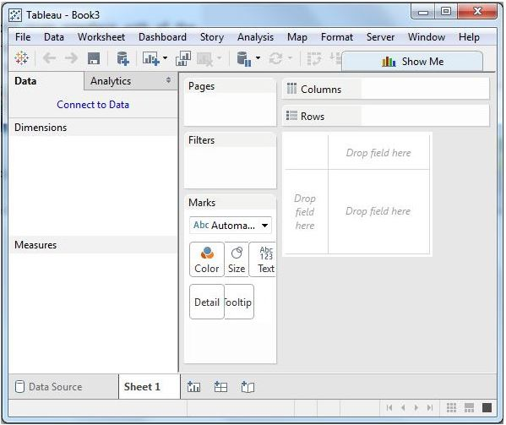
Menu

Slide 9
File Menu
This menu is used to create a new Tableau workbook and open existing workbooks from both the local system and Tableau server. The important features in this menu are −
Workbook Locale sets the language to be used in the report.
Paste Sheets pastes a sheet into the current workbook, which is copied from another workbook.
Export Packaged Workbook option is used to create a packaged workbook, which will be shared with other users.

Slide 10
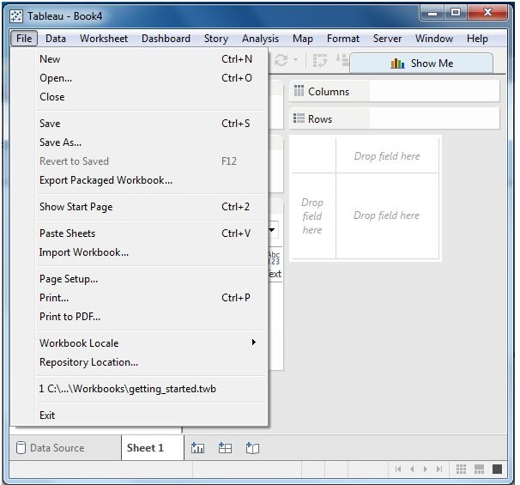

Slide 11
Data Menu
This menu is used to create new data source to fetch the data for analysis and visualization. It also allows you to replace or upgrade the existing data source.
The important features in this menu are as follows −
New Data Source allows to view all the types of connections available and choose from it.
Refresh All Extracts refreshes the data from the source.
Edit Relationships option defines the fields in more than one data source for linking.

Slide 12
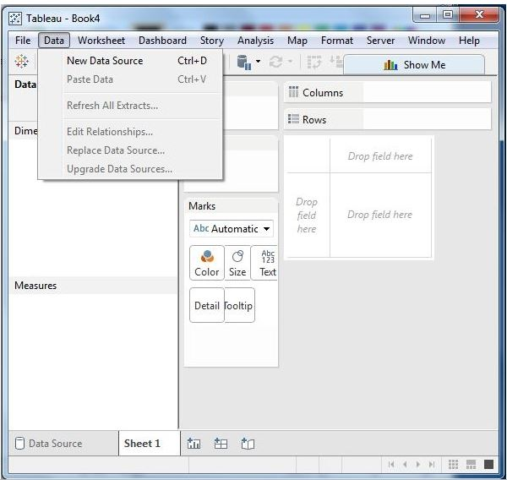

Slide 13
Worksheet Menu
This menu is used to create a new worksheet along with various display features such as showing the title and captions, etc.
The important features in this menu are as follows −
Show Summary allows to view the summary of the data used in the worksheet such as, count, etc.
Tooltip shows the tooltip when hovering above various data fields.
Run Update option updates the worksheet data or filters used.

Slide 14
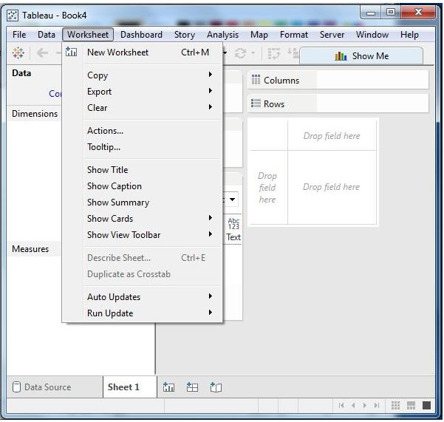

Slide 15
Dashboard Menu
This menu is used to create a new dashboard along with various display features, such as showing the title and exporting the image, etc.
The important features in this menu are as follows −
Format sets the layout in terms of colors and sections of the dashboard.
Actions link the dashboard sheets to external URLs or other sheets.
Export Image option exports an image of the Dashboard.

Slide 16
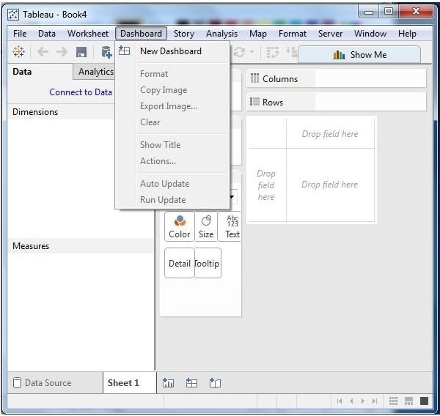

Slide 17
Story Menu
This menu is used to create a new story which has many sheets or dashboards with related data.
The important features in this menu are as follows −
Format sets the layout in terms of colors and sections of the story.
Run Update updates the story with the latest data from the source.
Export Image option exports an image of the story.

Slide 18
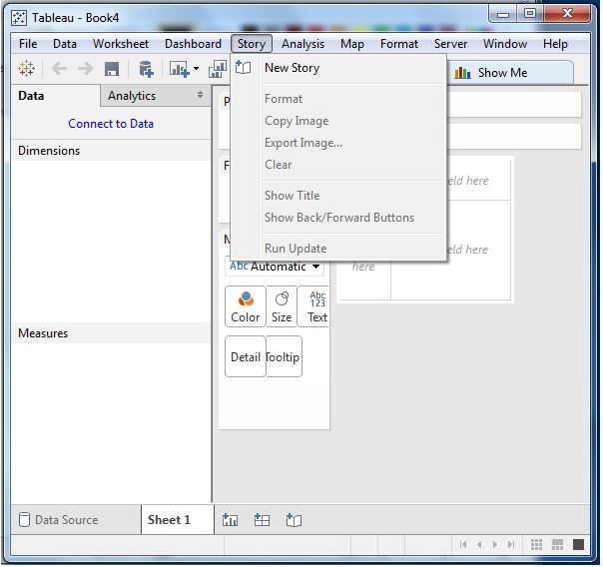

Slide 19
Analysis Menu
This menu is used for analyzing the data present in the sheet. Tableau provides many outof-the-box features, such as calculating the percentage and performing a forecast, etc.
The important features in this menu are as follows −
Forecast shows a forecast based on available data.
Trend Lines shows the trend line for a series of data.
Create Calculated Field option creates additional fields based on certain calculation on the existing fields.

Slide 20
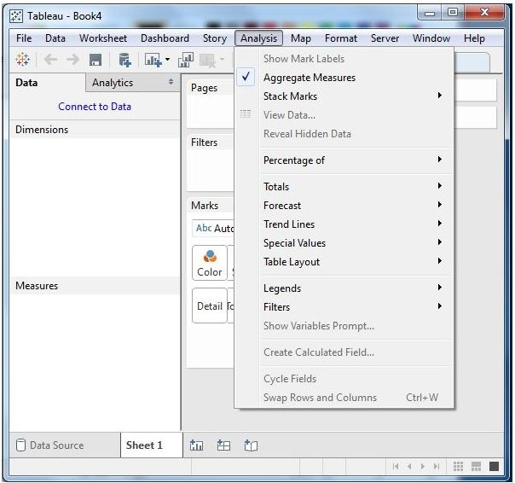

Slide 21
Map Menu
This menu is used for building map views in Tableau. You can assign geographic roles to fields in your data.
The important features in this menu are as follows −
Map Layers hides and shows map layers, such as street names, country borders, and adds data layers.
Geocoding creates new geographic roles and assigns them to the geographic fields in your data.

Slide 22
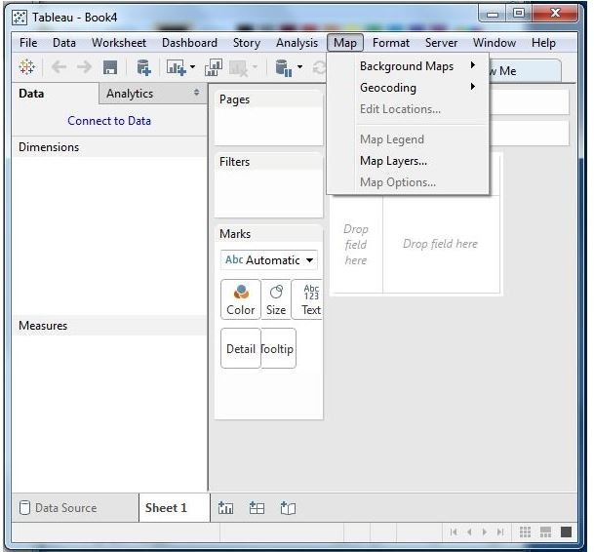

Slide 23
Format Menu
This menu is used for applying the various formatting options to enhance the look and feel of the dashboards created. It provides features such as borders, colors, alignment of text, etc.
The important features in this menu are as follows −
Borders applies borders to the fields displayed in the report.
Title & Caption assigns a title and caption to the reports.
Cell Size customizes the size of the cells displaying the data.
Workbook Theme applies a theme to the entire workbook.

Slide 24
Server Menu
Server Menu is used to login to the Tableau server if you have access, and publish your results to be used by others. It is also used to access the workbooks published by others.
The important features in this menu are as follows −
Publish Workbook publishes the workbook in the server to be used by others.
Publish Data Source publishes the source data used in the workbook.
Create User Filters creates filters on the worksheet to be applied by various users while accessing the report.

